Slide 1
SITE ATTENDANCE (V 1.0) PROJECT
Technical planning and demonstration

Slide 2
Introduction
A one of solutions for site attendance problem
Overcome as possible any disciplinary problems
Using “Punch-card” methodology or concept

Slide 3
Methodology
Punch-card concept:
Check in/out upon site
Has place, date and time
Additional feature: Remarks

Slide 4
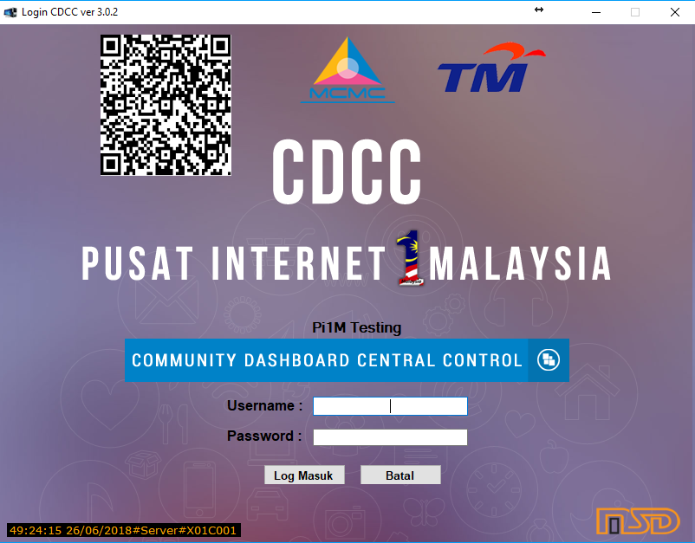
Features
On CDCC:
QR Code will appear on top left of login page
Encrypted data
Refreshed every 15 minutes – prevent from reuse

Slide 5
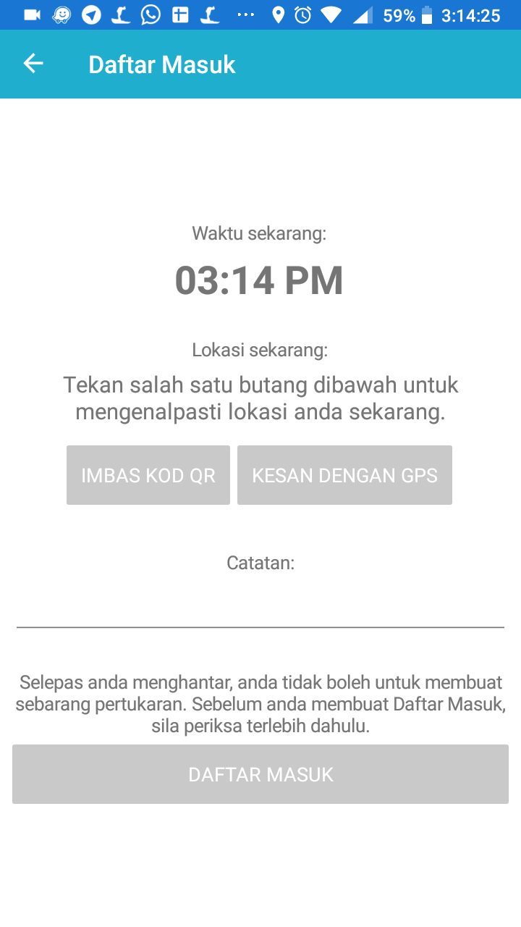
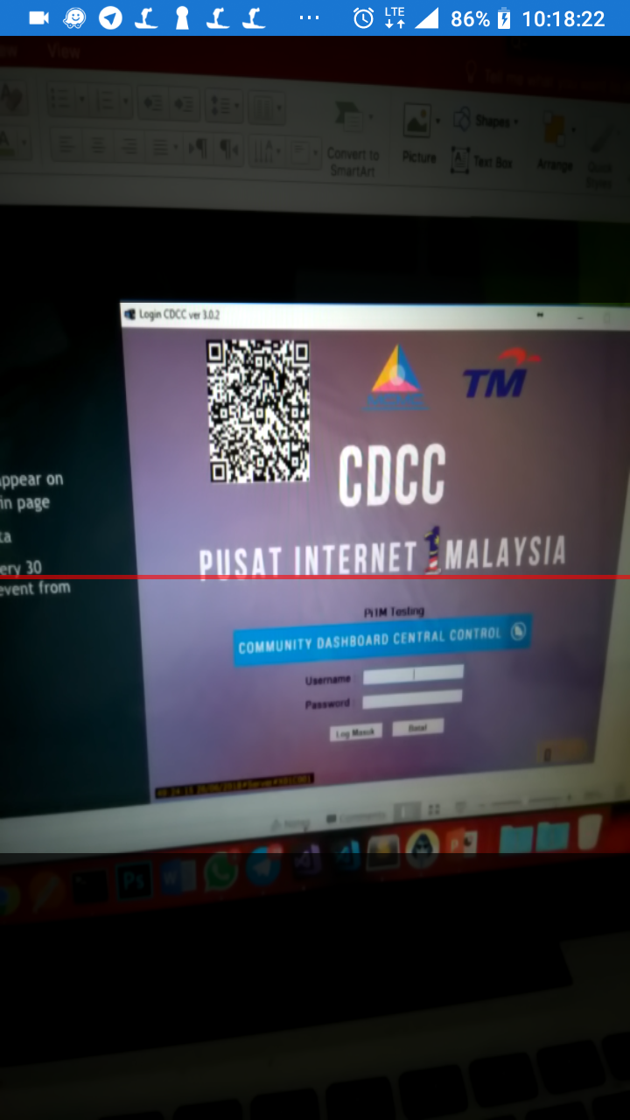
Features
On the Mobile app:
Real-time
User modified free
Imbas Kod QR
Scan on CDCC produced QR Code
Provide exact location
Kesan dengan GPS
Provide current location based on GPS
Catatan
Enables user to write any details

Slide 6
Features
Current:
GPS-spoof detector
Fake date and time detector
Dynamic QR code
Location detector
Offline record
Sync to server
History
Upcoming:
IMEI restriction per login
Multi-language
Designation
Reducing file size
Google Play Store availability

Slide 7
DEMO
Demo 1: Login
Demo 2: Check In/Out Using Valid QRCode Scanning
Demo 3: Check In/Out Using Invalid QRCode Scanning
Demo 4: Check In/Out Using Location
Demo 5: Check In/Out Without Location Marking
Demo 6: Check In/Out Using Invalid Date and Time
Demo 7: Check In/Out Using Modified GPS
Demo 8: Check History

Slide 8
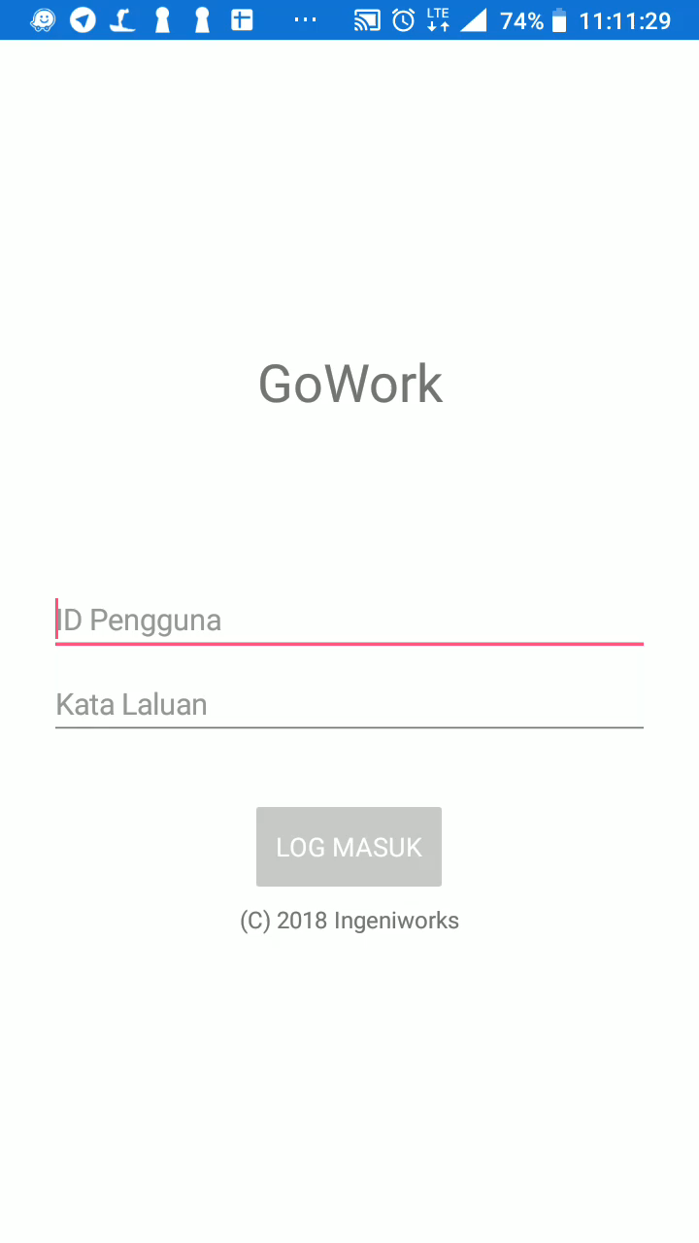
Demo 1: Login
Insert Staff ID and Password
Tap on ‘Log Masuk’ button

Slide 9
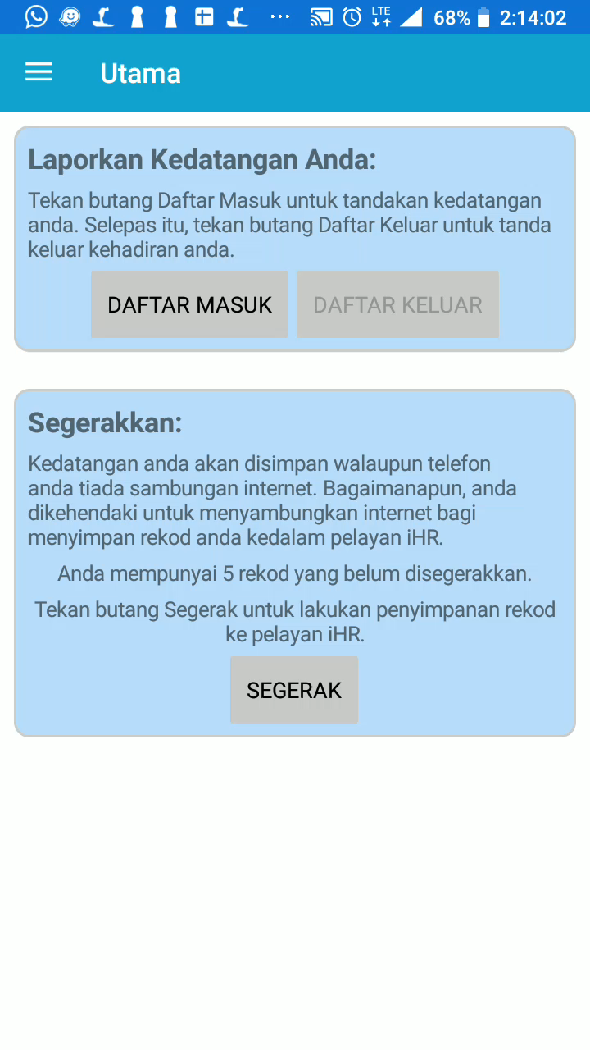
Demo 2: Check In/Out Using Valid QRCode Scanning
Scan the QRCode on CDCC
Location of site will shown
Insert ‘Catatan’ (optional)
Tap on ‘Daftar Masuk’ / ‘Daftar Keluar’ button
Check In/Out will succeed
Reported as Actual Check In/Out

Slide 10
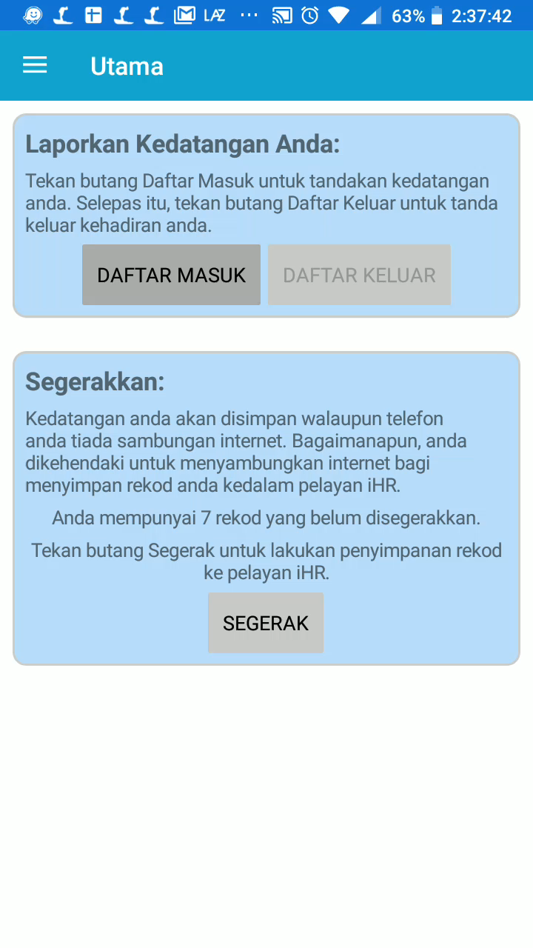
Demo 3: Check In/Out Using Invalid QRCode Scanning
Scan the QRCode on CDCC
Location of site will shown
Insert ’Catatan’ (optional)
Tap on ‘Daftar Masuk’ / ‘Daftar Keluar’ button
Check In/Out will not succeed and user requires to redo

Slide 11
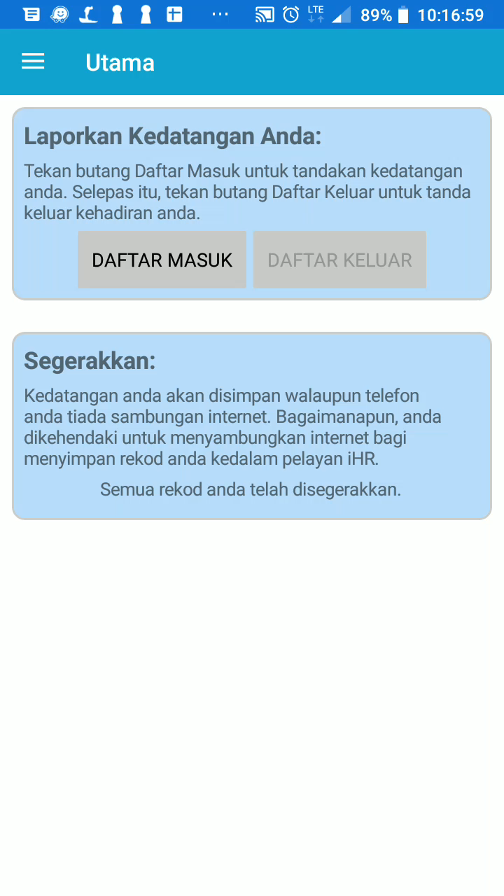
Demo 4: Check In/Out Using Location
Tap on ‘Kesan dengan GPS’ button
Location of current place will shown
Insert ‘Catatan’ (optional)
Tap on ‘Daftar Masuk’ / ‘Daftar Keluar’ button
Check In/Out will succeed
Reported as Manual Check In/Out

Slide 12

Demo 5: Check In/Out Without Location Marking
Not tap on Location button
Insert ‘Catatan’ (optional)
Tap on ‘Daftar Masuk’ / ‘Daftar Keluar’ button
Check In/Out will not succeed as no location identification is done

Slide 13
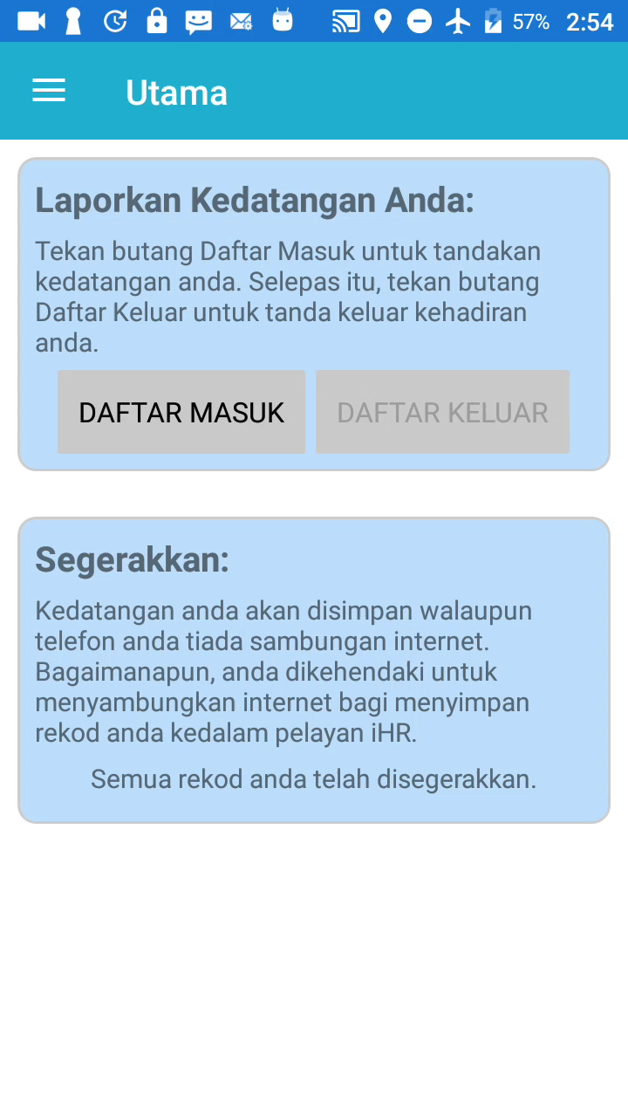
Demo 6: Check In/Out Using Invalid Date and Time
Set time manually on settings
Go to the app
Tap on ‘Daftar Masuk’ / ‘Daftar Keluar’ button
App will detect on invalid date time, and will automatically rejected from Check In/Out.

Slide 14
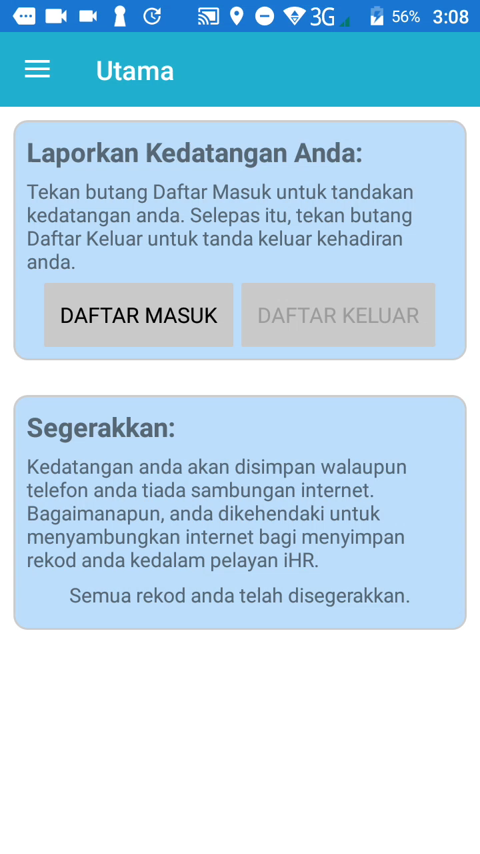
Demo 7: Check In/Out Using Modified GPS
Set GPS manually on any GPS-spoof apps
Go to the app
Tap on ‘Daftar Masuk’ / ‘Daftar Keluar’ button
App will detect the GPS is being modified, and will automatically rejected from Check In/Out.

Slide 15

Demo 8: Check History
Tap on Menu
Tap on History
Tap on any of History list

Slide 16
TECHNICAL PLANS
Targeted sites
Targeted users
App development plans
Date of commencing

Slide 17
Technical Plans: Targeted Sites
Pilot Phase
20 sites
15 sites from West Malaysia
Normal Sites
Low Priority – sites that have stable infrastructure
Medium Priority – sites that have less stable/poor infrastructure
5 site from Sabah and Sarawak
Special Site
High Priority - site that remotely far and poor infrastructure
As a measurement of app reliability and stability

Slide 18
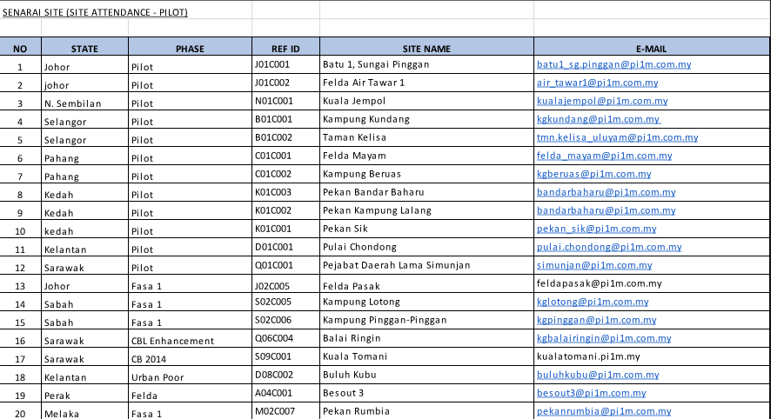
Technical Plans: Targeted Sites
Sites:

Slide 19
Technical Plans: Reason for Pilot Project
20 sites will be the sample of users of the app. (20 sites x 2 users = 40 users)
Users indirectly acting as the testers for the app.
Plenty of resources (variant phones can be tested in same time)
Expected to have much of bugs.
To avoid same redundant bugs reported by tons of sites.
Final development stage before distribution to all sites.

Slide 20
Technical Plans: Targeted Users
Android
First to get the app
First to received updates
First to fix the bugs
Expected to have bunch of stability issues due to different architectures
IOS
Updates will be received after Android
Stability issues will be less due to using same architectures (except Ip5c and below)
No GPS and DateTime spoofing applied as Apple isn’t permit user to do that.
No plan for other OS (Tizen, Symbian, Blackberry OS)

Slide 21
Technical Plans: App Development
Bugs, Requirements and Suggestion
Divided to three categories of priority zone
Red
Will be quickly done and published within (at least) a Week, depends on its complexity and technical requirements.
Crucial bugs, as well as premature crash, should be on this category
Yellow
Will be done and published within (at least) a Month, depends on its complexity and technical requirements.
Requirements should be on this category
Green
Will be done and published on the next version of app, duration should be after app is considered stable.
Low priority requirements and all suggestions should be on this category.

Slide 22
Technical Plans: Date of Commencing
Suggestion date of commencing:
1st week of July 2018
All pilot sites will be announced on using this app and compulsory to install.
CDCC Team and Mobile Team will prepare on app distribution during on this week.

Slide 23
Technical Plans: Date of Commencing
Suggestion date of commencing:
2nd week of July 2018
CDCC installer will be made available to all 20 pilot phase sites.
Android installer (APK) will be published on:
Ingeniworks server (Server 1)
Google Drive Share (Server 2)
and possibly via NoFile.io (Server 3)
Every updates also will be published on same servers. There will be not available via Google Play Store, at this time.
This to ensure the developer to identify on which sites are successfully installed and which sites are have problems during installation.
Any queries will be noted and will be categorized.

Slide 24
Technical Plans: Upcoming Plans
Fixing Red Zone bugs reported by sites, and will be published to server immediately.
IOS will be published via TestFlight (need to install). TestFlight requires voucher code that will be distributed via registered user email. There will be not available on Apple App Store, at this time. IOS will be made available on August 2018.
This app will be made available to all sites around Q4 of 2018.
App interface design and additional features will be discussed later and will be categorized as Green Zone priority. For this version, we are focusing on app availability, stability, and usability.
Policy discussion (if any)

Slide 25
That’s All, Thank You
Any suggestion and comments, or furthering discussion?
Suggestion for app will be immediately categorized on Green Zone

